Slide 1

Capstone project 1 Airbnb data analysis
By:-
Vivek Kumar Soni
Ashish Kumar

Slide 2
What is Airbnb data Analysis?
Airbnb is a company which is used for operate in for lodging, primarily homestays for vacation ,rentals and also for tousism activity..
We can relate Airbnb just like Uber rooms and online hotel booking platform.

Slide 3
Detailed of Airbnb booking:
Guests and hotels have used Airbnb to expend on travelling possibilities and present a more unique ,personalized way of experiencing the world since 2009. Data analysis of listing provided through Airbnb is a crucial factor for the company. Listing which is generate a lot of data – data that can be analysing and used for security, business decision, understanding of customers and providers behaviour and performance on the platform ,guiding marketing initiative ,implementation of innovative additional services and much more. Today Airbnb became one of a kind services that is used and recognized by the whole world.

Slide 4
Problem Statement:
We have to find the analysis Airbnb :
We will finding out the distribution of every Airbnb listing based on their location, including their place range, room type, listing name and other related factors.
Our main objective is to find out the key metrics that influence the listing of properties on the platform . For this, we will explore and visualize the dataset from Airbnb in NYC using basic exploratory data analysis.
Data analysis on thousand of listings provided through Airbnb is a crucial factor for the company.

Slide 5
Understanding the Data
Name price
Id minimum nights
Host id Number of reviews
Host name Last review
neighbourhood group Reviews per month
Neighbourhood Calculated per month
Latitude Calculated host listing count
Longitude availability
Room type

Slide 6
Problems:
What can we learn about different hosts and areas?
What can we learn from predictions?
Which hosts are the busiest and why?
Is there any noticeable different of traffic among different areas and what id be the reason for it?
What is the average preferred price by customer according to the location?
Number of active hosts per location?

Slide 7
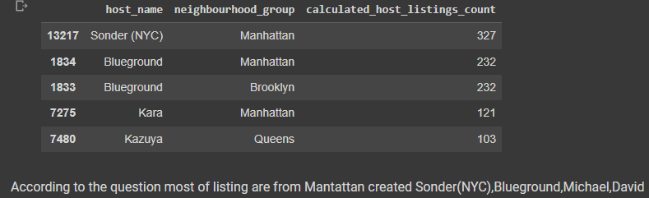
1.What can we learn about different hosts and areas?

Slide 8
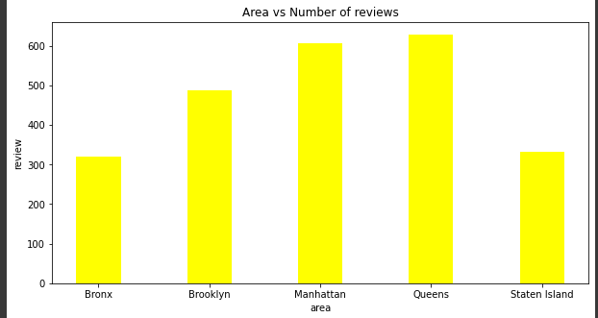
2.What can we learn from predictions?

Slide 9
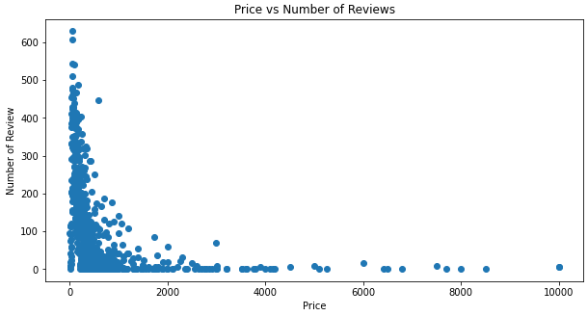

Slide 10
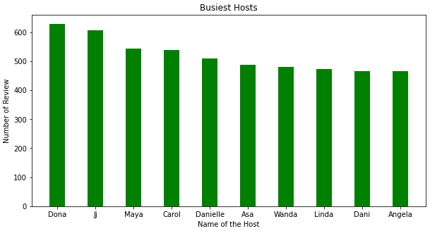
3.Which hosts are the busiest and why?

Slide 11
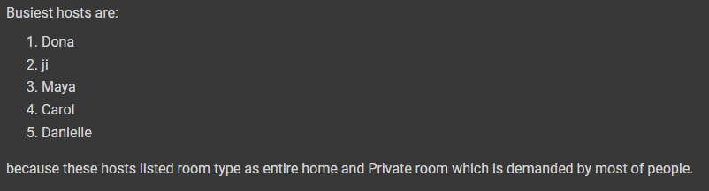

Slide 12
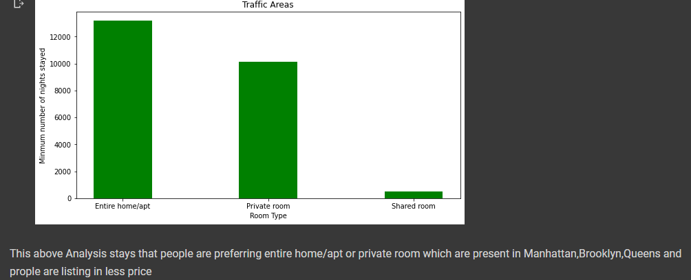
4.Is there any noticeable difference of traffic among different areas and what could be the reason for it?

Slide 13
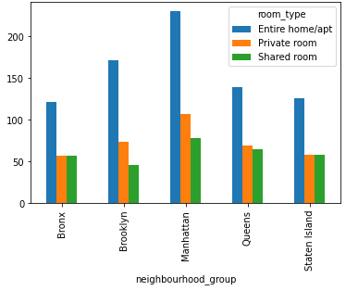
5.What is the average preffered price according to the location?

Slide 14
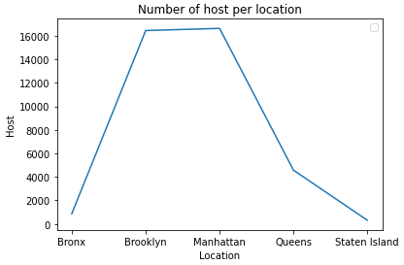
6.Number of active hosts per location?

Slide 15
Conclusion:
1.In that particular neighbourhood only peoples who prefer to stay in entire home or apartment they are going to stay bit longer.
In compared to home and apartment peoples who prefer to stay in private room .they don’t stay longer.
Most people prefer to pay less price.
If there are more number of reviews for particular neighbourhood group that means that price is a tourist place.
Those peoples are traveller who don’t stay more then one night.
There are some entries in dataset which have minimum nights but it respective price is zero.
We replace the price value with mean value of price which has less than 100$.

Slide 16
Analysis Summary:
Manhattan is the most focused place for hosts to do their business.
For the three type room type(i.e. Entire home,shared room and private room) average price of entire home .
Customers pay highest amount in Brooklyn,Queens and Manhattan that is $10000 and lowest amount is $10.
Top three host base on their turnover are Sonder(nyc), Red awning,Henry and best host is Sonder(NYC).

Slide 17
Thanking you…

